Slide 1

Phishing Awareness Training: Safeguarding Your Digital Life
Phishing is the leading cause of cyberattacks globally, with 90% of all cyberattacks starting with a phishing email. Business Email Compromise (BEC) scams alone cost businesses billions each year. This training will equip you with the knowledge to recognize and avoid these threats.
Notes:
1

Slide 2
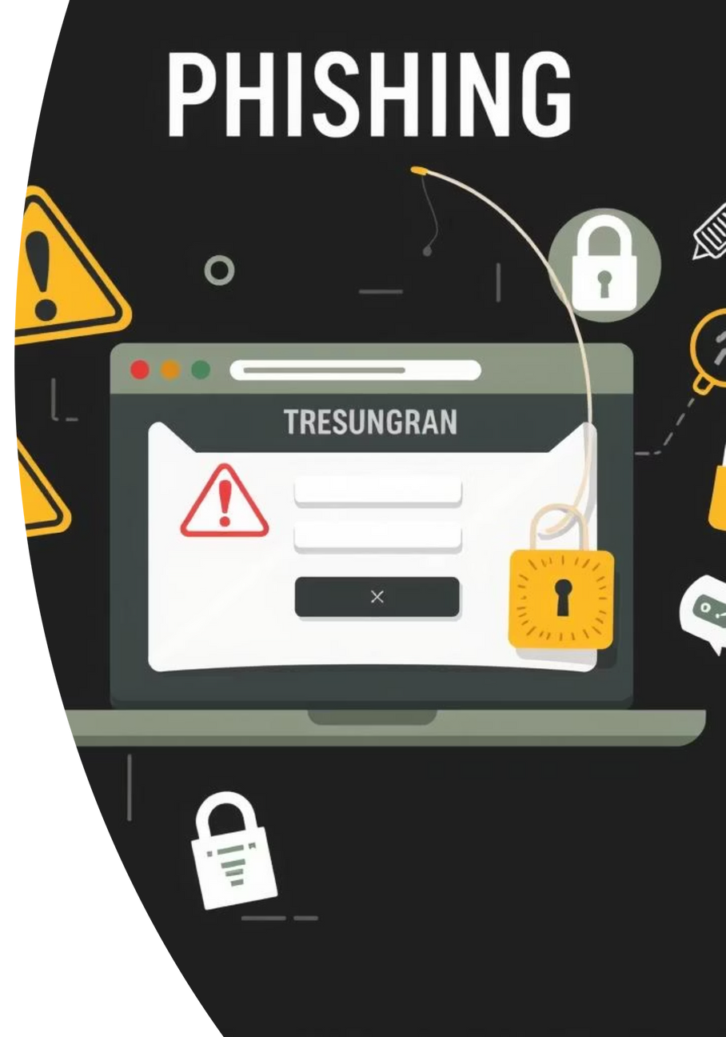
What is Phishing?
Definition
Malicious attempts to trick individuals into revealing sensitive information (credentials, financial data) or installing malware.
Goal
Gain unauthorized access, commit fraud, or deploy ransomware. Phishing affects 1 in 10 email users monthly.
Common Types
Spear phishing (targeted), whaling (executives), smishing (SMS), and vishing (voice calls).
Notes:
2

Slide 3

Recognizing Phishing Emails: Red Flags
Suspicious Sender
Mismatched "From" name and email address; generic domains.
Generic Greetings
"Dear Customer" instead of your name.
Urgency/Threats
"Account will be suspended in 24 hours," "Immediate action required."
Spelling/Grammar Errors
Unprofessional language, typos, awkward phrasing.
Suspicious Links/Attachments
Hover over links to reveal true URL; never open unsolicited attachments.
Notes:
3

Slide 4

Spotting Fake Websites and Malicious Links
URL Mismatch
The visible link text differs from the actual URL (e.g., `microsoft.com` but links to `malicious-site.ru`). Always verify the true destination.
No HTTPS/Padlock
Legitimate sites use `https://` and have a padlock icon in the browser bar. A missing padlock or `http://` indicates an unsecured connection.
Poor Design
Low-resolution logos, broken links, inconsistent branding, or non-functional features often indicate a fraudulent site.
Domain Squatting
Watch for slight variations of legitimate domains (e.g., `amaz0n.com`, `g00gle.com`). These are designed to trick you.
Notes:
4

Slide 5

Social Engineering: The Human Element
Social engineering is a manipulation tactic that exploits human psychology rather than technical vulnerabilities. Attackers prey on emotions like trust, curiosity, fear, urgency, or the desire for gain to trick individuals into divulging confidential information or performing actions against their best interest.
Common tactics include pretexting (fabricating a scenario), baiting (tempting with a false promise), and quid pro quo (promise of a service for information). Remarkably, 98% of cyberattacks leverage social engineering, highlighting its effectiveness.
Notes:
5

Slide 6
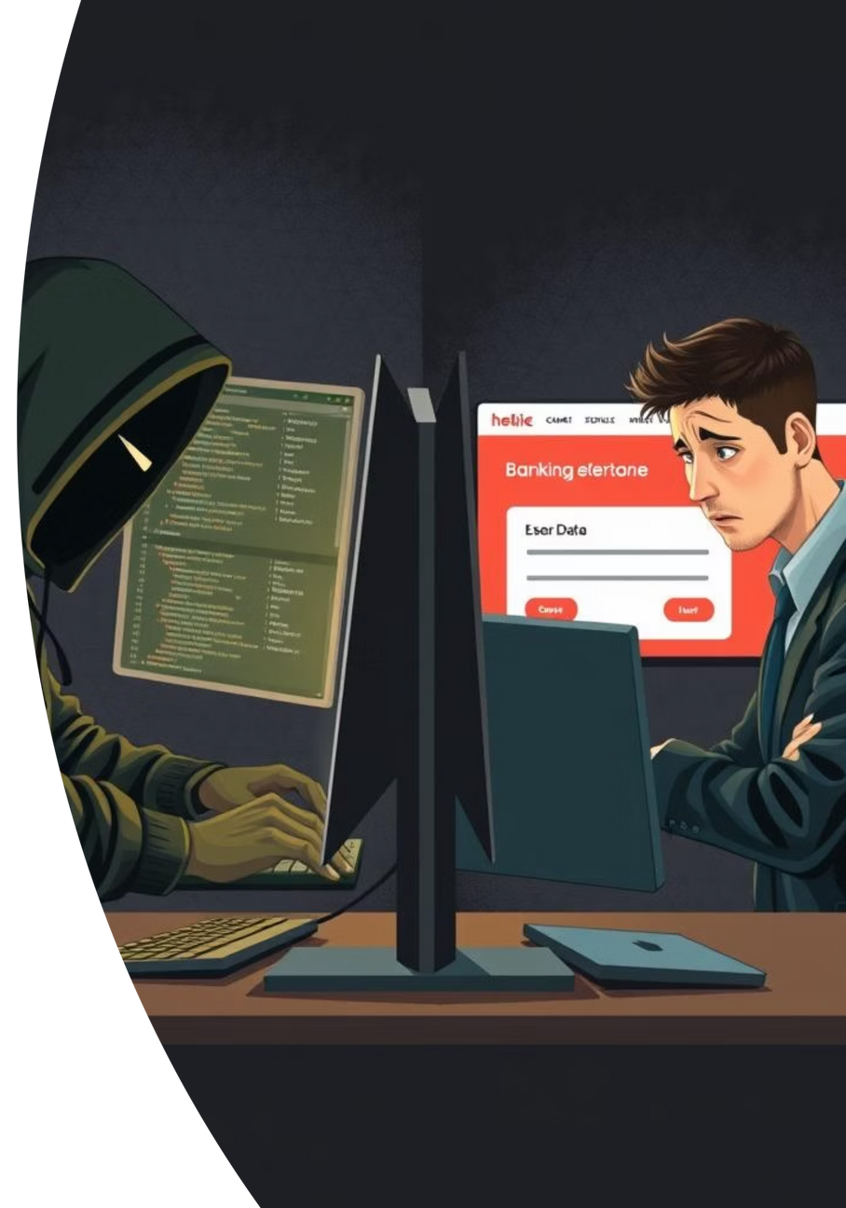




Common Social Engineering Lures
Urgency/Scarcity
"Limited time offer," "Immediate payment required."
Authority
Impersonating CEO, IT support, bank, or law enforcement.
Curiosity/Greed
"You've won a lottery," "Click here for shocking news."
Familiarity/Trust
Impersonating a known colleague to request transfers.
Notes:
6

Slide 7
Real-World Phishing Examples
Microsoft 365 Credential Harvesting
Gift Card Scams
Impersonators (often CEOs) email employees asking them to purchase gift cards for urgent, fake reasons, resulting in millions lost.
Attackers create fake login pages to steal corporate email credentials, a tactic that saw a 61% rise in 2023.
W-2 Tax Scams
Invoice/Payment Fraud
Phishers impersonate executives to trick HR into sending employee W-2 forms, affecting thousands.
Attackers send fake invoices or alter legitimate banking details for vendor payments, with an average loss of $89,000 per incident.
Notes:
7

Slide 8






Best Practices & Defense Strategies
Verify Before You Click
Multi-Factor Authentication (MFA)
Always double-check sender details, URLs, and context.
Implement MFA on all accounts; it blocks over 99.9% of attacks.
Strong, Unique Passwords
Report Suspicious Emails
Use complex passwords and a reliable password manager.
Use your company's designated phishing report button.
Keep Software Updated
Think Before You Act
Patch operating systems and applications to fix vulnerabilities.
Pause and evaluate before responding to unusual requests.
Notes:
8

Slide 9

Interactive Quiz: Test Your Phishing IQ!
1
Scenario 1
Identify which email is a phishing attempt based on the "From" address and urgency.
2
Scenario 2
Determine if a website is fake by examining its URL and security indicators (HTTP/HTTPS).
3
Scenario 3
Recognize the social engineering tactic used in a given example (e.g., urgency, authority).
4
Question
What is the most critical step to take if you receive a suspicious email? (A. Delete it, B. Reply and ask, C. Report it to IT, D. Click the link).
Notes:
9

Slide 10








Conclusion: Your Role in Cybersecurity
Vigilance is Key
You are the First Line of Defense
Phishing attacks are sophisticated and constantly evolving.
Your awareness protects company data and resources.
When in Doubt, Don't Click!
Stay Informed
Continuously update your knowledge on new threats.
Always verify through an independent channel.
Together, we build a stronger, more secure digital environment.
Notes:
10

